Slide 1

ABHAY KUMAR
REGISTRATION NUMBER : (42310001)
ROLL NUMBER : (22S315008)
M.E : (CSE)

Slide 2
PROJECT TITLE:
HEART DISEASE PERDICATION USING MACHINE LEARNING ALGORITHMS:

Slide 3
Presentation Outline
Coadding And Testing
Simple Code
Results From The Test Data Set
Results And Discussion: Input And Output GUI
Results
Conclusion And Future Work
References

Slide 4
COADING AND TESTING:
1) Software Requirement:
1. Anaconda : It is an open-source software available to us which has been enables us to easily code in using python or R on different operating systems such as the windows, Linux, and Mac OS. It has been millions of users worldwide and is well known as the industry which helps us in developing the systems, testing them, and training the machines. This is further enables us to:
• Manage all the imported libraries, And their dependencies, and the environments of developing with Anaconda.
• In developing techniques method to train our machine with TensorFlow, And scikit-learn, etc.
• it is Analyze the datasets and manipulate the with Dask, NumPy, pandas, and Numb
• The Visualize or plot the results with Matplotlib, Holoviews, Bokeh, and Data shader. It is also providing us with jupyter notebooks which has all the in-built libraries embedded in the already. This eases our coding stress, and also helps us code with more efficiency results.
2. Python: The most abundantly used general high level programming language. It is used for both a small scale and big scale systems. It can be easily be interpreted. And It is said to support multiple programming paradigms. It is including features of procedural, object-oriented, and functional programming together. It is already garbage-collected which makes it more efficient.
3. Numpy: It is a python programming library. This is basically helps us to deal with large datasets, matrices, and multi-dimensional arrays. It is also providing us with several mathematical functions which help us and ease the calculations. It is an open-source software available to all.
4. Pandas- It is a library that is written in python Programming language. It is helps us with the analyzing of data. It is also providing us with tools and functions to manipulate a large amount of dataset.
5. Sklearn : It is a library used in machine learning Algorithms in python programming language. It is mainly helps us with the classification of data,And regression of models, and in clustering algorithms. These algorithms include SVM, random forest etc.
6. Tensorflow- It is a highly know as open-source software, which is free and available to all. It is used for differentiable programming with a large number of tasks dataset. It is used against large data sets to help us with the dataflow, and its manipulation. It is a basically a math library with various features.

Slide 5
2 )OBJECTIVES AND TYPES OF TESTING:
Testing is the performed so that we can be locate problems. It is the method of identifying all the possible faults of any system. Also, it is acts as method to test the functionality of all the individual components and the system. It is the process of verifying that the hardware system And performs its functionalities and meets user needs and expectations. Testing ensures that even if the product fails, it is fails in a controlled condition that can be managed later. There are various types of test. Each of the test is used to address a particular testing needs.
2.1 UNIT TESTING This testing means it is including the creation of test scenarios that verify that program is working in the way it can be supposed to. In this type of testing, the objective is to validate that each module or unit is performing the tasks that it is supposed to do. A unit is the smallest part that must be tested.
2.2 INTEGRATION TESTING These tests are made just to check the different parts after that they have been integrated to determine whether they are functioning properly as a unit or not. This type of testing is driven by events and is more curious about the outcomes of the component. Integration tests show that although the components are working properly as individual but also the combination of components is also working properly.
2.3 FUNCTIONAL TESTING These kind of tests are providing systematic demonstration of the functions tested and the proof of their functioning being successful. Functional testing is targeted at a valid input, invalid input, functions, output, procedures. And The preparation on functional tests is focused on the requirements, key functionalities, different and extreme test cases
2.4 SYSTEM TESTING This is type of tests tells us whether the whole system after all its parts has been joined together meets the need of shareholders. It is checks and confirms the known and expected results. These kinds of testing are done to check whether the system delivers what it was supposed to. It can be checks whether the all the parts work well with each other or not.
2.5 WHITE BOX TESTING It is done in a way such that the tester has been information about all the components, workings, structure and architecture of the hardware/software. It is used for deep level testing to ensure that those places that are not accessible by a black box test are covered in white box testing. It basically means that there shall be no blind spots in the system.
2.6 BLACK BOX TESTING Here the testing that is done on the software/hardware by someone who has been no information on how to operate it. Before a product is developed some documentation is done, they include requirement analysis documents that has all the details about what a product must be. Now these tests are based on those sources only. Imagine a black colored box, you can be not seeing into it. You know nothing about what it contains. This is exactly how the testing is done.

Slide 6
3) TESTING IN MACHINE LEARNING:
Very easily put, in machine learning Algorithms is a type of system/application which is based upon models that are use prediction and analysis. Building these systems is a hard task, but testing and validating the entire system is even more difficult. And The Traditional methods of testing are always based on stationary inputs. And The output will also be fixed as the input remains fixed, but in the case of machine learning, the system has been built along with the input, which will be change or modify as we come to know more and more about it, therefore unlike the traditional system, the output here will be never remain fixed. Hence, the strategies for testing a machine learning system must be a bit different. Below are some of these strategies mentioned that can be used in testing the machine learning systems.
1. Development of training datasets: Here, a subset of dataset that is used for training purpose, which means it can be used to train the system to obtain the given prediction. It is supervised, i.e., the output is given along with the input.
2. Development of testing data sets: The testing data set is a training data subset that has been built in an intelligent way to check the how robustly our system has been trained and to check all the combinations that are possible. The resultant model will be finely tuned according to the outputs of the testing dataset.
3. Development of validation and correction test suite: This is based on algorithms and test datasets. For e.g., in our Project system scenarios consist of clustering results based upon the different factors/attributes and creating profiles of risk depending upon behaviors and demography.
4. Understanding the algorithm: All of this is dependent upon calculations and how the different algorithms use different calculations. Some algorithms like regression-based algorithms give some numeric results regressively, or continuously. On the other hand, And there are some algorithms that are calculate the results by dividing the outcomes into different parts or behaviors, and then some algorithms are create to multiple layers between the input and output layer. Continuous mathematically numeric variables such as return on investment.
5. Using Statistics for conveying the results : The Outcomes are generally predicted in the form of working model, or a numeric value or a working interface or something like that. But in machine learning algorithms, the use of bars, histograms and other statistical diagrams it is used to depict the prediction or analysis in a more comparative or mathematical method way. (The machine learning models will usually have approximate, and not actual results upon validation. In conclusion, software testing is as crucial and important a task in machine learning, as is in any other traditional system, but unlike those systems , our testing is based on more dynamic factors and generally will produce a relative or approximate result which can be best shown statistically).

Slide 7
4) TEST CASES:
SR NO. | TEST CASE NAME | TEST CASE DESCRIPTION | EXAMPLE TEST CASE | EXPECTED OUTPUT
1 | Equivalence Partitioning | This divides the input dataset of a software unit into a partitions of equivalent data from which can be test cases can be derived. | The dataset can be divided into two classes based on the number mapped with state. The valid partitions are : Mapped State Valid Invalid 0,1 Any no. other than 0,1. | If valid: Successful. invalid: Unsuccessful.
2 | Boundary Value Analysis | In this we focus on the boundary values of the various valid and invalid inputs data. | We want to test the value of the age to be a positive integer values. | If valid: Successful. invalid: Unsuccessful
3 | Data input | To check what happens when the data is inputted in the wrong format. | Instead of giving the input in 0’s and 1’s. The data is fed into the system as alphabets. For example, Sex of the person. | The code must be throwing an error pertaining to change of format of the data inputted.

Slide 8

SIMPLE CODE:
https://github.com/Abhayku18113211/Heart-Disease-Prediction-System-Using-ML

Slide 9
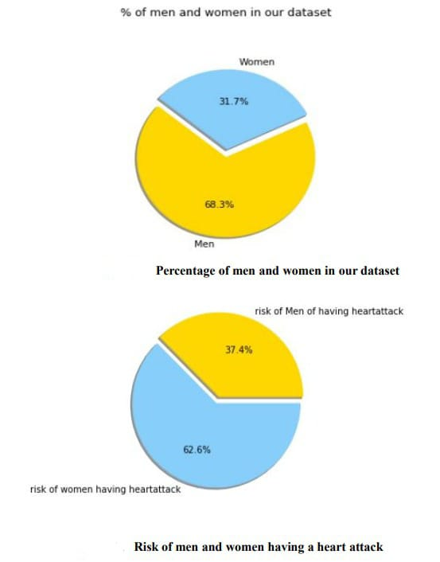
RESULTS FROM THE TEST DATA SET:
We have done extrapolation of data set in regards to heart disease on basis of various factors which are Sex, Age, Blood pressure, Serum cholesterol and so.

Slide 10
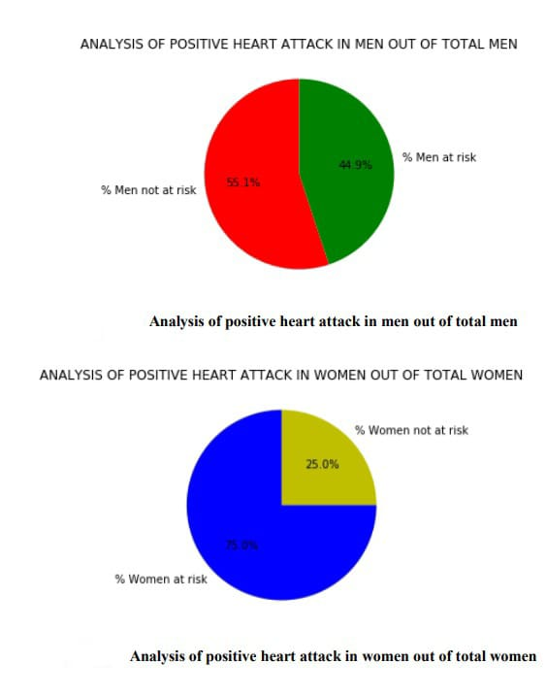
ANALYSIS OF POSITIVE HEART ATTACK IN MEN OUT OF TOTAL MEN AND WOMEN OUT OF TOTAL WOMEN:

Slide 11
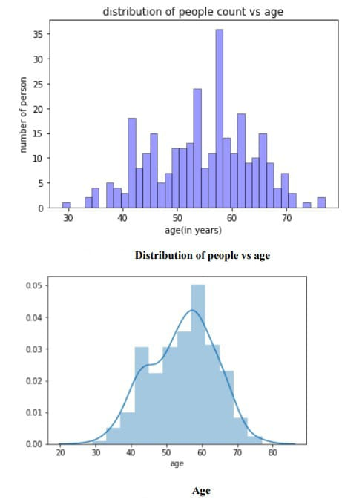
Distribution of people vs age:

Slide 12
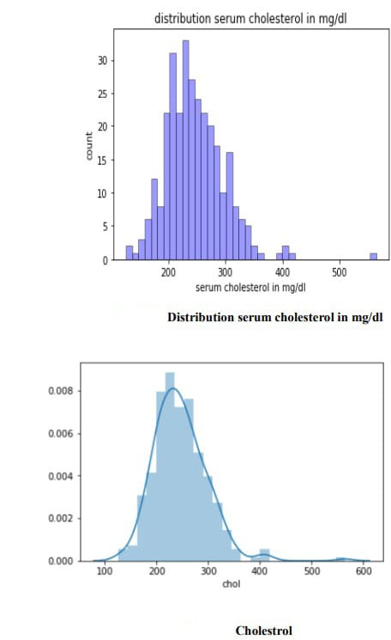
Distribution serum cholesterol in mg/dl:

Slide 13
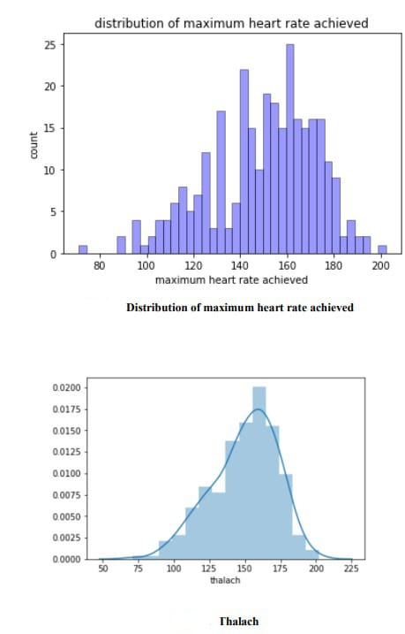
Distribution of maximum heart rate achieved:

Slide 14
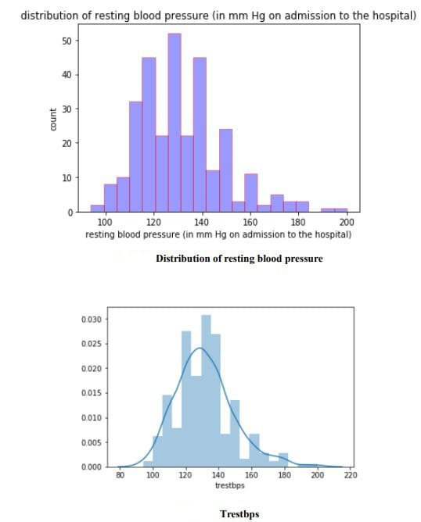
Distribution of resting blood pressure:

Slide 15
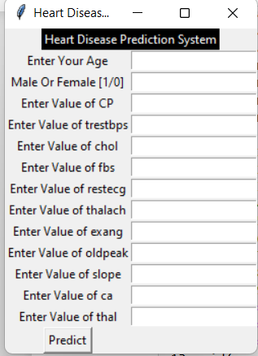
Result And Discussion: INPUT AND OUTPUT GUI
Here we are going to create and Predict the patients details through GUI for our project. So, anyone can perform predictions using this GUI.
INPUT:

Slide 16
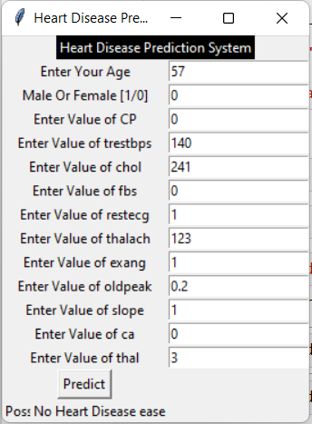
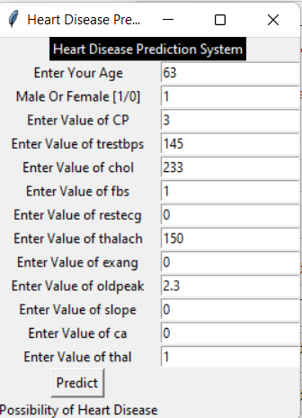
OUTPUT

Slide 17
RESULTS :
After the performing of machine learning Algorithms approach for training and testing we find that accuracy of the Random Forest is better compared to other algorithms. Accuracy Results is calculated with the support of the confusion matrix of each algorithm, here the number count of TP, TN, FP, FN has been given and using the equation of accuracy, value has been calculated and it is concluded that extreme gradient boosting is best with 95.08% accuracy and the comparison is shown below.
TABLE: Accuracy comparison of algorithms Algorithm Accuracy
Algorithms | Accuracy %
Logistic Regression | 85.25%
Naïve Bayes | 85.25%
SVM | 81.97%
K-Nearest Neighbors | 67.21%
Decision Tree | 81.97%
Random Forest | 95.08%
XG-Boost | 85.25%
Neural Network | 80.33%
Ada-Boost | 73.6%

Slide 18
CONCLUSION AND FUTURE WORK:
CONCLUSION:
• Heart diseases is a major silent killer in the India and throughout the world, and it’s the application of promising technology like machine learning algorithms is to be the initial prediction system of heart diseases will be to a profound impact on society. The early prognosis of heart disease can be aid in making decisions of lifestyle changes in a high-risk patients and in turn reduce the complications, which can be a great milestone in the field of medicine. The number of people facing heart diseases is on a raise every year. This prompts for its early diagnosis and treatment also. The utilization of suitable technology support in this regard can be prove to be highly beneficial to the medical fraternity and patients. In this paper, the eleven different machine learning algorithms used to measure the performance are SVM, Decision Tree, Random Forest, Naïve Bayes, Logistic Regression, Adaptive Boosting, and XG Boost ANN , KNN, Linear Regression, DNN Extreme gradient boosting are applied on the dataset. The expected attributes leading to heart disease in patients are available in the dataset which contains 76 features and 14 important features that are useful to evaluate the system are selected among them. If all the features taken into the consideration, then the efficiency of the system the author gets is less. To increase are efficiency, attribute selection is done. In this n features have to be selected for evaluating the model which are gives more accuracy results. In this The correlation method of some features in the dataset is almost equal and so they are removed. If all the attributes dataset present in the dataset are taken into account, then the efficiency decreases considerably. All the Eleven machine learning methods accuracies are compared based on which one prediction model is generated. Hence, the aim is to be use various evaluation metrics like confusion matrix, accuracy, precision, recall, and f1-score which predicts the disease efficiently. Comparing all Eleven the extreme gradient boosting classifier gives the highest accuracy of 95.08%
FUTURE WORK :
The work done here trains the system with a limited number of datasets. The machine learning algorithms become more accurate once they are fed with a huge number of data sets. So, this system can be trained with a huge number of data sets that would increase the accuracy in predicting the heart diseases. The analysis part of the system is done, and in order to be more useful can be integrated with electronic systems which give the system real-time inputs and would help the patient get the results then and there. There are multiple combinations of algorithms that can be tested against these data sets in order to yield better results.
For the Future Scope more machine learning approach will be used for best analysis of the heart diseases and for earlier prediction of diseases so that the rate of the death cases can be minimized by the awareness regarding the diseases. The analysis part of the system is done, and to be more useful can be integrated with electronic systems which give the system real-time inputs and would help the patient get the results then and there. There are multiple combinations of algorithms that can be tested against these data sets in order to yield better results.

Slide 19
REFERENCES:
[1] Amines Hazra, Arkomita Mukherjee, Amit Gupta, Asmita Mukherjee, “Heart Disease Prediction Using Machine Learning and Data Mining Techniques: A Review”, Research Gate Publications, July 2017, pp.2137-2149.
[2] V. Krishnaiah, Narsimha, Heart Disease Prediction System using Machine learning Techniques and it is utilizing the Intelligent of The Fuzzy Approach methods way in a Review paper International Journal based paper of Computer are Applied in Applications, 14 February 2017
[3] Guizhou Hu, Martin M. Root, "Building heart disease Prediction Models for Coronary artery Heart Disease by Synthesizing Multiple Longitudinal Research Findings”, European Science of Cardiology, 11 May 2005.
[4] Mythili, Dev Mukherji, Nikita Padilla and Abhi ram Naidu, “A Heart Disease Prediction Model using SVM- Decision Trees- Logistic Regression (SDL)”,International Journal of Computer Applications, vol.68,15 April 2013
[5] Nimai Chand Das Adhikari, Arpana Alka, and Rajat Garg, “HPPS: Heart disease Problem Prediction System using Machine Learning”.
[6] K. Polaraju, D. Durga Prasad, “Heart Disease Predication of using Multiple Linear Regression Model", International Journal of Engineering Development and Research Development, ISSN:2322-9939, 2017.
[7] Marjia Sultana, Afrin Haider, “Heart Disease Prediction model using WEKA tool and 10-Fold cross-validation”, The Institute of Electrical and Electronics Engineers, 18 March 2017.
[8] Dr.S.Seema Shedole, Kumari Deepika, “Predictive analytics to prevent and control chronic of heart disease”, https://www.researchgate.net/punlication/316530781,January 2016.
[9] Ashok kumar Dwivedi, “To Evaluate the performance of different types of machine learning techniques for prediction of heart disease using ten-fold And cross-validation 16 September 2016.
[10] Megha Shahi, R. Kaur Gurm, “Heart Disease Prediction System using Data Mining Techniques and Machine Learning Algorithms Techniques ”, Orient J. Computer Science Technology, vol.5 2018, pp.467-466
[11] Purushottam, Prof. (Dr.) Kanak Saxena, Richa Sharma, “ The Efficient Problem of Heart Disease Prediction System”, 2017, pp.962-969

